Slide 1


Super Charge
You’re Azure Learning
Gregor Suttie aka Azure Greg

Slide 2
Super Charge
You’re Azure Learning
Gregor Suttie aka Azure Greg

Slide 3

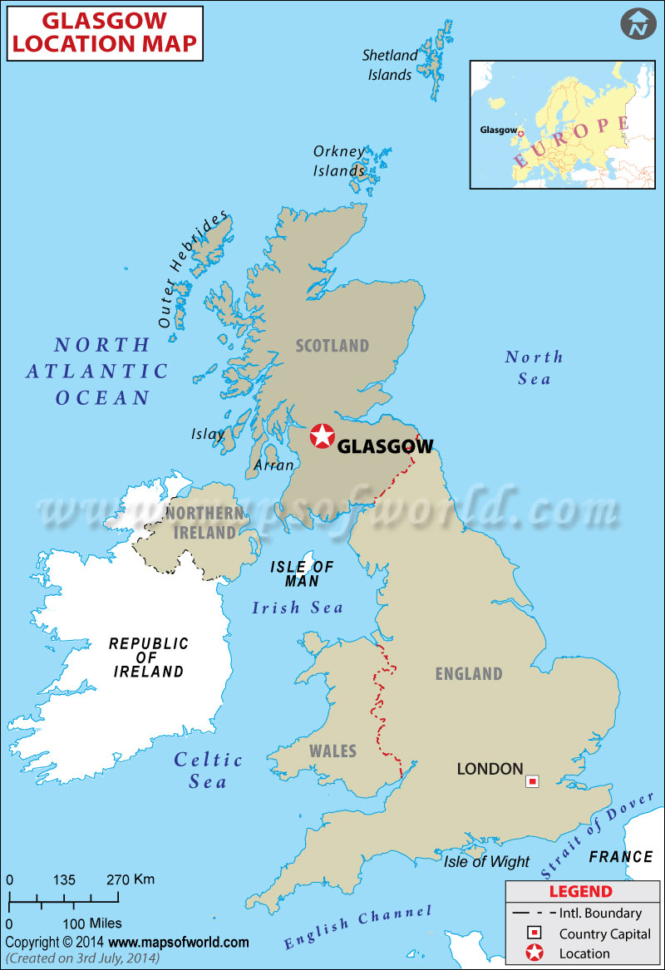
Speaker Intro
20+ years experience as a developer
Head of Development for Sword IT in Glasgow
Co-organise the Glasgow Azure User Group
Run the Azure Global Bootcamp, Glasgow edition
My personal blog is at gregorsuttie.com
Microsoft MVP in Azure
I help organise some Azure community content
Notes:
Before we jump in here is a brief introduction to me
I have 20+ years experience in IT and I have a developer background
I am currently the Head of Development for Sword IT in Glasgow, Scotland
I help organise the Glasgow Azure User Group
I run the Azure Global Bootcamp, Glasgow edition
I blog on all things Azure at gregorsuttie.com
I am a Microsoft Azure MVP since August 2019
And I help organise some Azure Community events

Slide 4
Agenda
My Journey
Exam Information
Learning Material / Demo’s
Takeaway’s
Questions
Notes:
Todays Agenda looks like this
I am going to be covering
My Journey – where I'm gonna talk a little about my journey and how I learned a huge subject area like Azure from scratch.
Next I’ll cover exam information, how to get started with the exams, where to find useful links and info on the Azure exams.
Then we will take a look at the learning resources and materials I have found useful when learning Azure and for studying for the exams.
And to round off I’ll talk about takeaways from this session and then open it up to questions.

Slide 5



My Journey
2017
2018/19
2020
1
2
3
Start
Failure
Today
November 2017
What didn’t go to plan
Where I am now
Notes:
All journeys have to start somewhere.
I started this journey I am currently on in November 2017.
Next I want to briefly touch on failure, not something many people talk about it but its an important part of learning and learning from failure.
Then I’ll cover where I am Today on my journey just to give you some context around my journey on learning Azure.
So lets dive in to the first part of my talk – my journey.

Slide 6

My Journey
2017
Starting out
1
I wanted to change my career direction
I took some time to think above the next move
I had no knowledge of Azure whatsoever
I chose to learn Azure and studied 2 hours a night
Start
November 2017
Notes:
It was November 2017
I was working for a large bank here in Glasgow on 1 huge project, the project was a mission critical web app and I was a senior dev on the team, I had been working on the same project for 2 years and I was starting to get itchy feet. The project was what I would call a feature factory, 2 weeks sprints working on the same project day in day out was becoming dare I say it a bit dull.
I wanted to do some Cloud development work but internally they were doing other things.
I decided I wanted to learn more about Azure and so I started to try to learn Azure in my spare time.
Now, everyone knows how starting to learn something as huge as Azure is, can be quite daunting and it was daunting.
When I put my mind to learning something I go all in.
I would spend 2 hours a night every night to try to learn the basics.

Slide 7
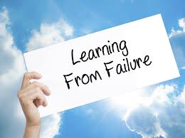
My Journey
2018/19
Failure
2
I failed the very first Azure exam I had ever taken
I failed the second Azure exam
I have since failed a further 2 Azure exams
What did I learn from failure?
Failure
What didn’t go to plan
Notes:
Lets talk quickly about failure, which is something you might not hear much about in this day and age.
I studied like crazy for a long time, and one day I noticed a tweet mentioning new Azure exams and then a blog post talking about some new Azure exams coming out.
I signed up for 2 of the beta exams for the Azure Administrator exams which was
AZ-100 – Microsoft Azure Infrastructure and Deployment
AZ-101 – Microsoft Azure Integration and Security
If you know me I don’t do things by half I like to jump right in
I booked both exams and had 2 weeks to prep for both exams, let’s go I said to myself.
I sat both Beta exams and narrowly failed both of them.
What did I learn from failure?
Poor preparation – I didn’t prepare for the exam
Poor planning – I rushed into the 2 exams head first
I didn’t study the right material – I was reading Microsoft docs articles
I didn’t do hands on learning, I read blog posts and books
I learned I needed to do hands on learning for me to take it in and repeat the practice

Slide 8
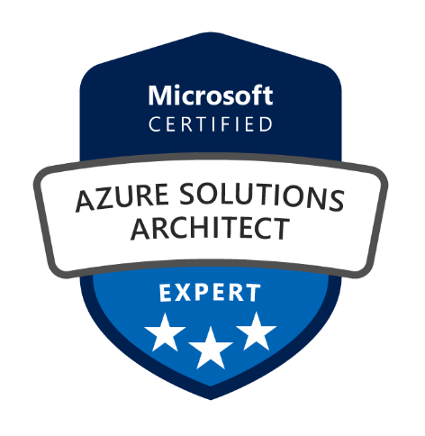
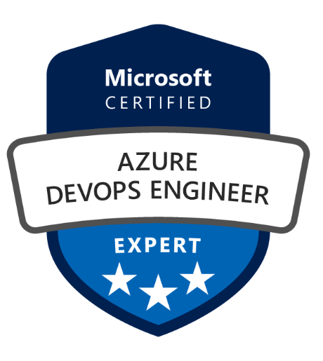
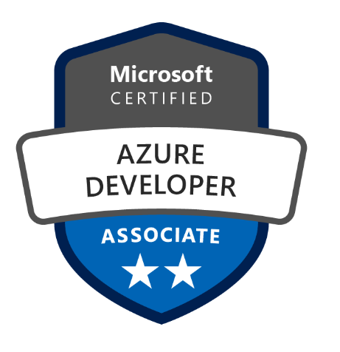

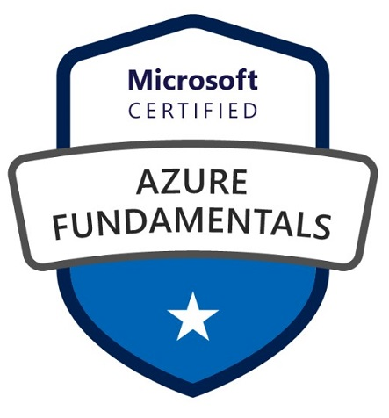
My Journey
2020
Today
3
I am a Microsoft MVP in Azure
Technical author on a published Azure book
Spoken at a Conferences
Give back to the community
Passed 9 Azure exams in total now
Today
Where I am now
Notes:
Moving on in my journey I want to talk to you about where I am today.
The main reason is to try to convey how you can go on your own journey and learn a something like Azure, although I don’t recommend trying to learn it all.
I became an Azure MVP within 2 years of learning Azure, I think the main reason for this is because I give back to the community.
I wrote study guides for the exams I had sat which turned out to be hugely popular.
I was once told think of the person coming along behind you, they might be on a similar journey, and if you share what you learn then maybe just maybe that will help that person on their journey.
The good news is that after failing the initial 2 exams I have since passed 9 Azure exams and have blog posts covering them, although a little out of date now I expect.
Lastly as part of my journey I encourage you to blog, blog what your doing at work (if you can), blog about your learning, someone will find it useful I'm pretty sure of that.
Opportunities appear out the blue when your active on places like Twitter and blogging, I’ve been lucky enough to be invited to speak and write guest articles etc., don’t be shy in blogging and joining the communities on twitter like #sqlfamily or #cloudfamily, #azurefamily etc

Slide 9
My Goals
Pass an Azure Exam
Pass the Azure Architect Exams
Speak at Conferences
Notes:
For me its important to have goals
I set goals for myself every 3 months – stretch goals not something simple.
You can see here the long term goals I had before I started with learning Azure.
I had a 4th goal at the back of my head but I didn’t put it up on the slides as I quickly learned that becoming an MVP was not something that should be a goal – becoming an MVP is a by product of what you give back to the community.
I will admit though that I wrote the letters MVP and pinned them on the wall above my monitors at home and when I struggled for motivation, this would remind me of one of my goals.
I would recommend that people have goals – if you don’t have goals its easy to float around and really not get where you want to be.

Slide 10
What Questions do you have?

Slide 11
Azure Exams
Notes:
Ok so lets now switch gears a little but and talk about the Azure Exams.
One thing I’d like to highlight about the Azure exams is that due to the current pandemic the exam labs have been removed – so now might be a good time to do them if you were thinking about it.

Slide 12
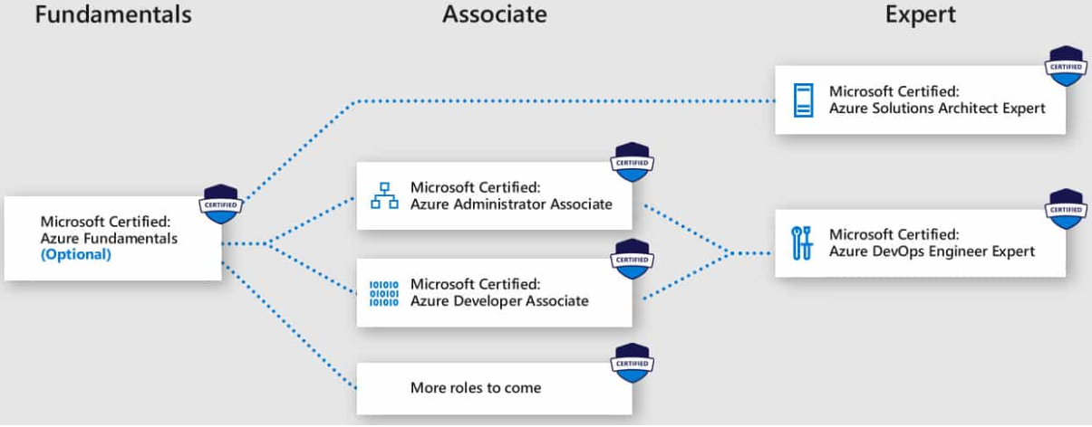
Azure Exams
https://docs.microsoft.com/en-us/learn/certifications/browse/?term=azure
Azure Fundamentals
Data Engineer
Solutions Architect
Azure Administrator
Any many more…
Notes:
There are new exams coming out every month it seems
Q) People always ask me the best way to take exams, online or go to a test centre? A) First exam test centre, do the rest at home if you can, due to circumstances, online only and no labs at the moment.
Q) How much do the exams normally cost ? A) $165 each unless you have a voucher or sitting a beta exam
Q) Where can you book the exams?
A) browse to the exam page and register their its fairly straight forward
Proctored exams Tips
Before exam: -
Check your computer assessment on the prometric vue website, you don’t want caught out.
Sign in 30 minutes early, Have your id handy, you may need to take photo of your id and room etc before hand so make sure your early.
Do not leave the camera window or cover your mouth – they can and have failed people for things like this.

Slide 13
Azure exam info
Blog - https://www.microsoft.com/en-us/learning/community-blog.aspx
Twitter - https://twitter.com/LibertyMunson
Build5nines - https://build5nines.com/certifications/
Official Study Guides - https://partner.microsoft.com/en-US/training/assets#/?type=Exam
Community Exam Study Guides - https://github.com/gsuttie/AzureResources/tree/master/Exams
Notes:
So this slide just shows some further Azure Exams info
- The official azure exam community blog
- Follow Liberty Munson on Twitter
- Build5nines.com has some great azure exam content as well as a great blog
- Exam Study Guides – this is one of my first stops for azure exam training

Slide 14
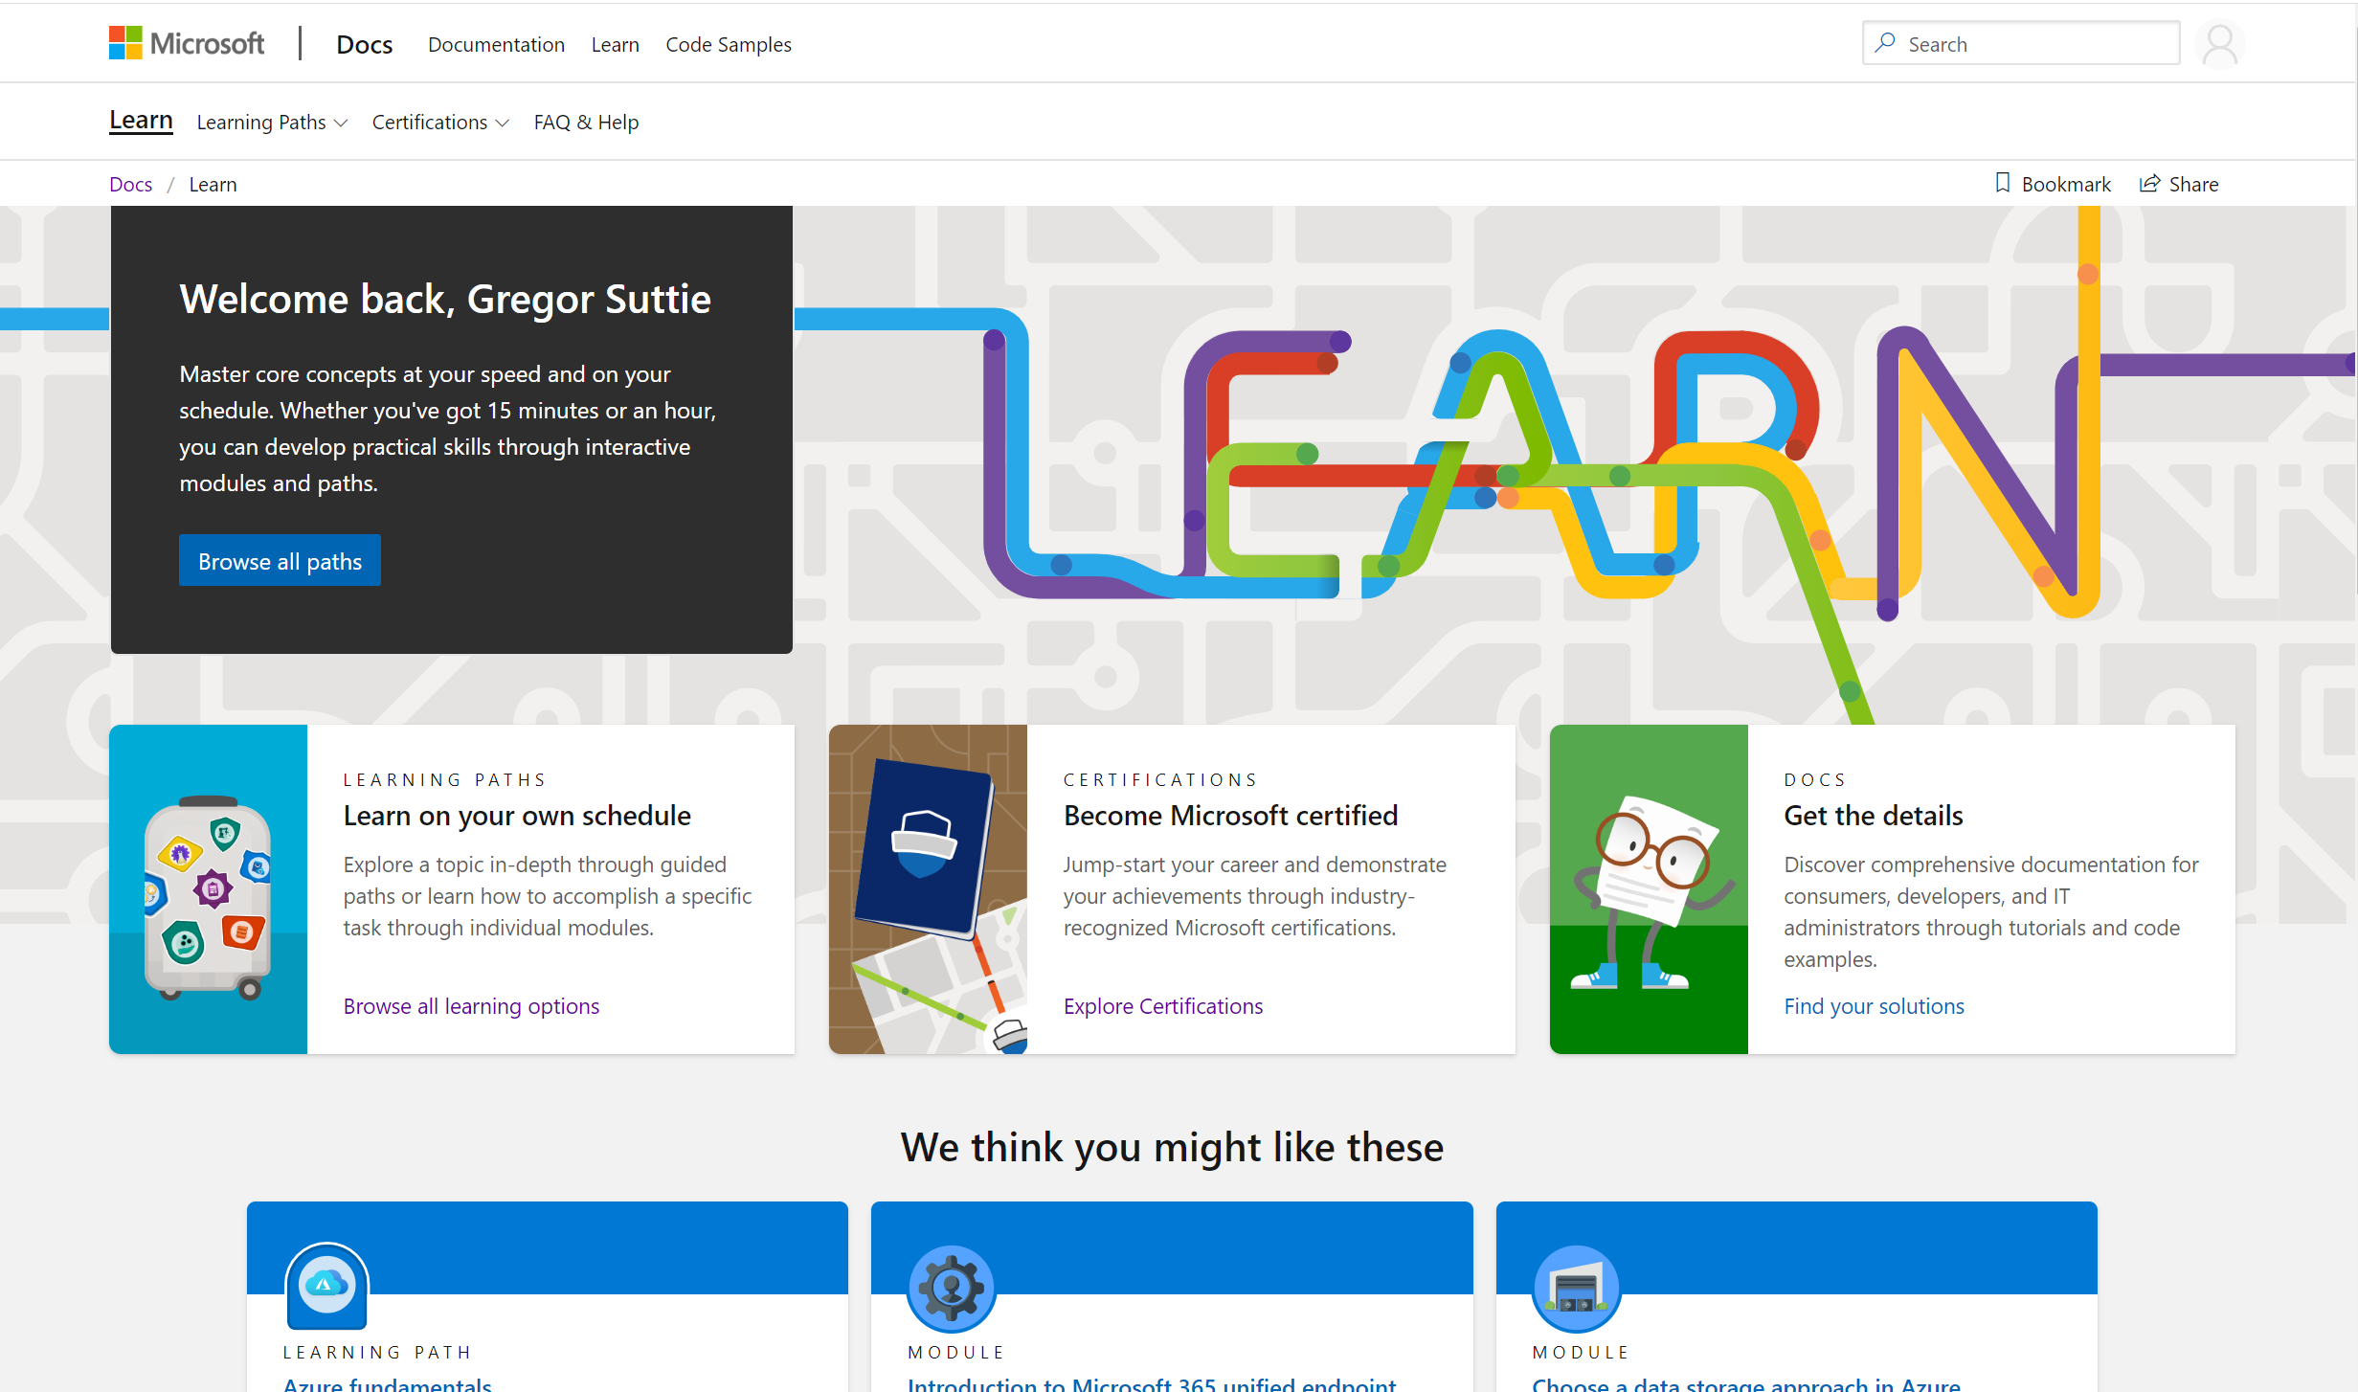
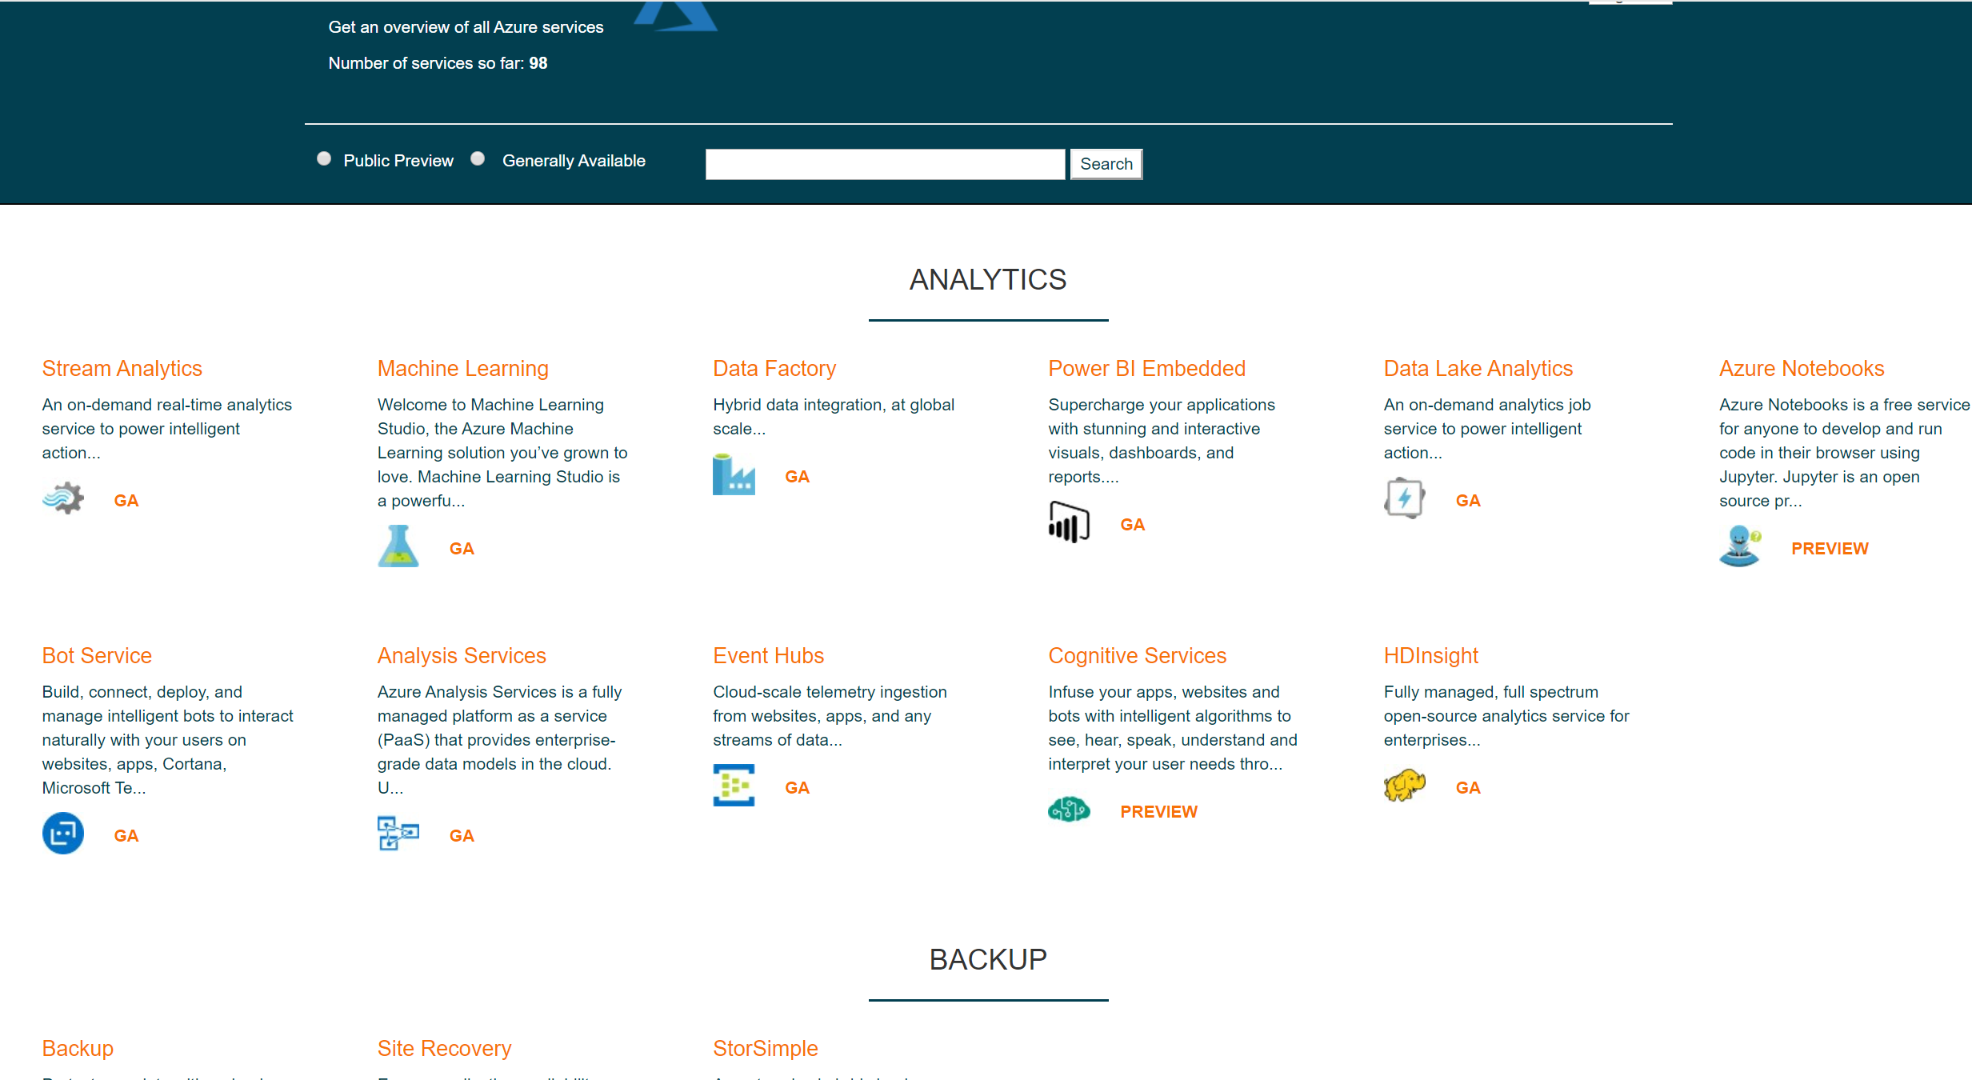
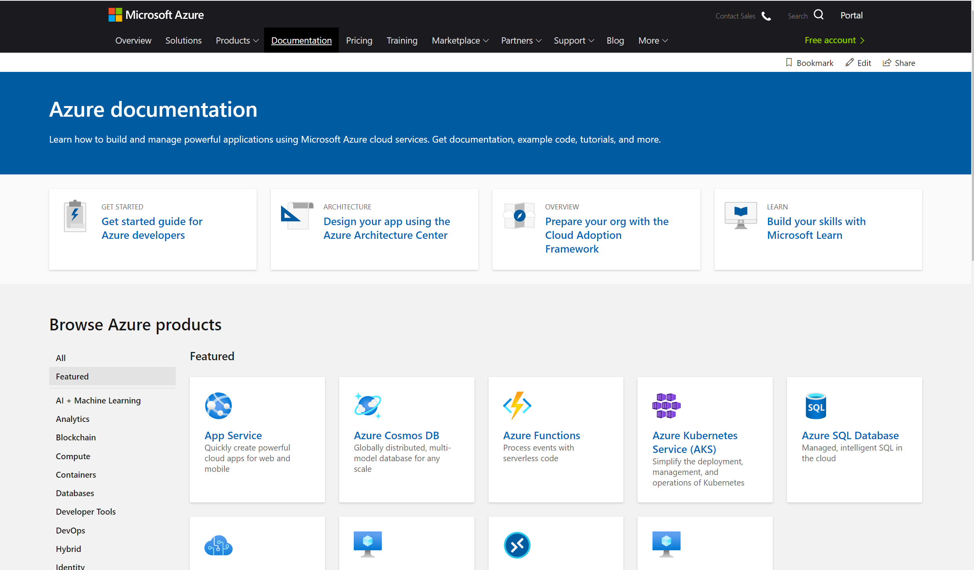
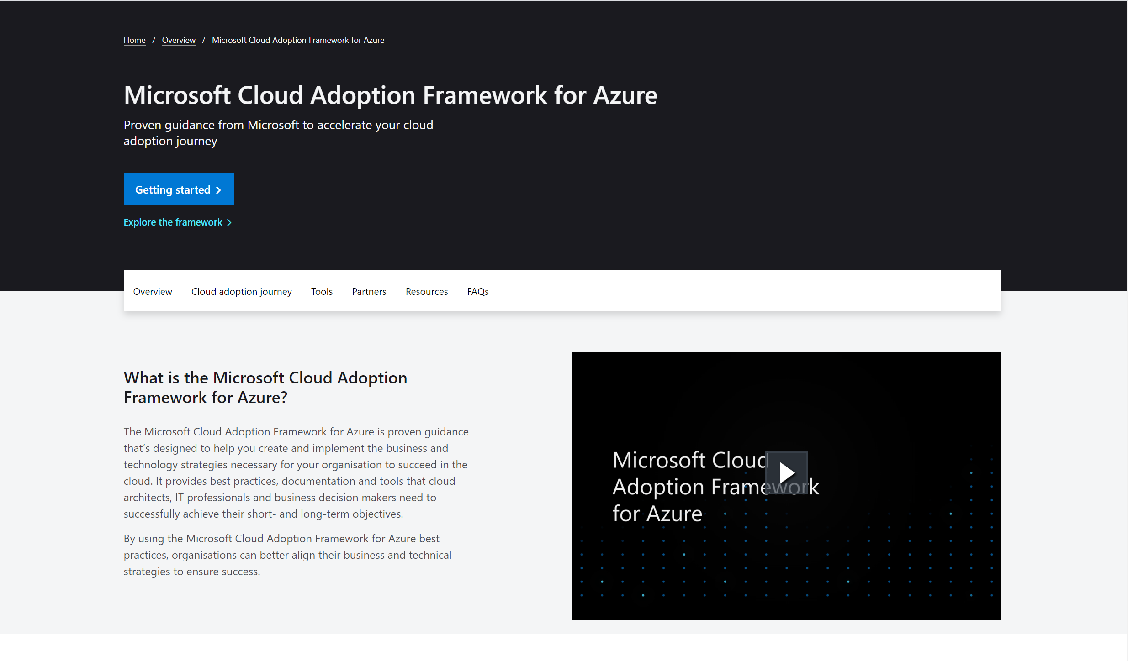
Where do I start?
Lot’s of great resources out there
Microsoft Learn
Azure-overview.com
Azure Docs
Cloud Adoption Framework
Notes:
So if you’re just starting out to learn azure or not far into your journey then here are a few resources I would recommend when starting out learning Azure.
Microsoft Learn
Azure Overview
Azure Docs
AzureCharts.com

Slide 15
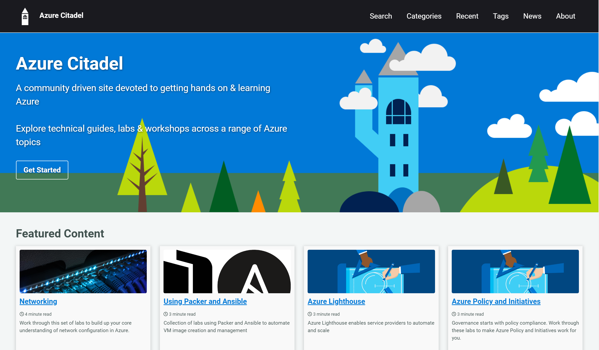
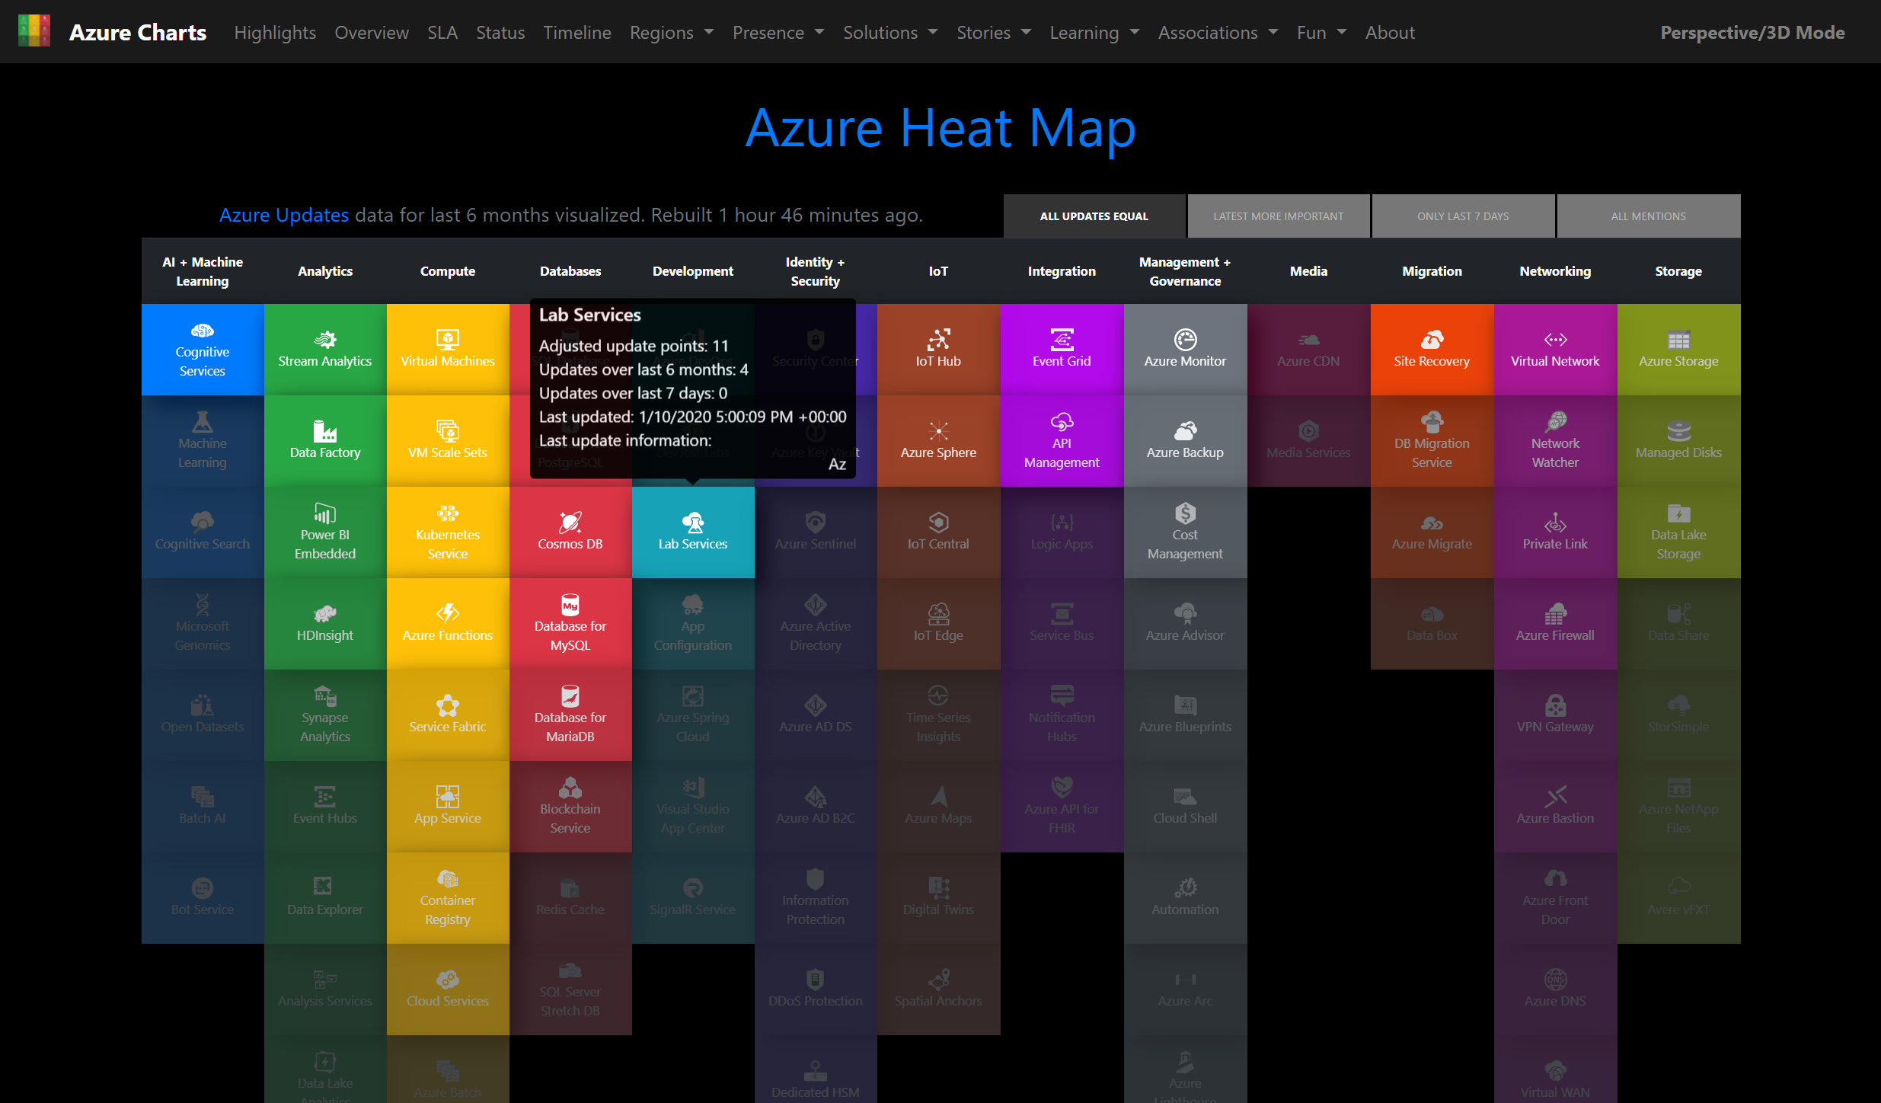
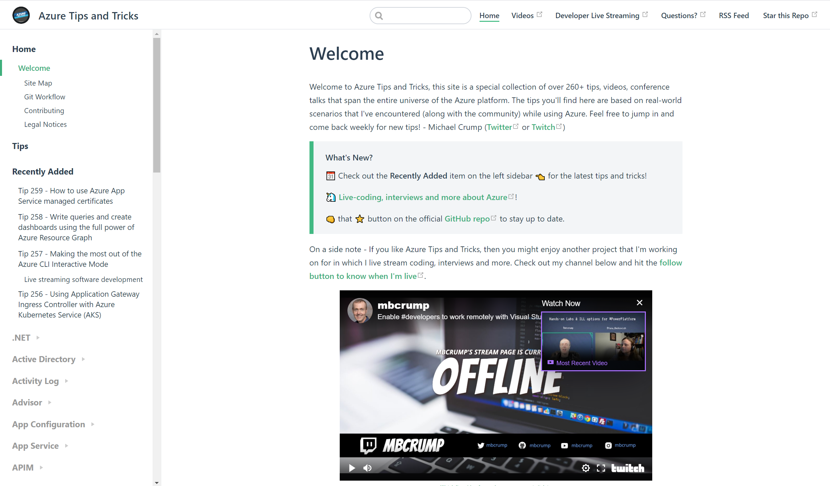
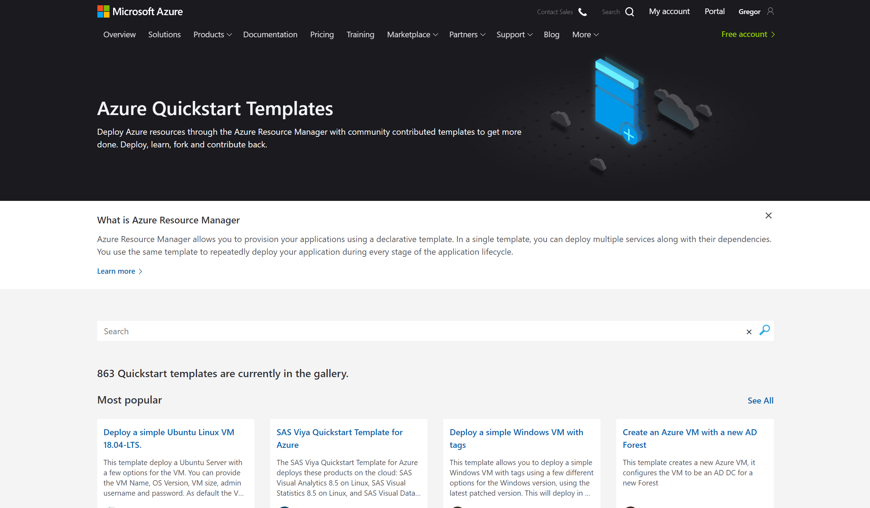
Middle of the Journey
Lot’s of great resources out there
AzureCitadel.com
AzureCharts.com
Azure Tips n Tricks
Azure QuickStart Templates
Notes:
If your familiar with Azure and looking for more useful resources then checkout these resources.
Azure Citadel
The Cloud Adoption Framework
Azure Tips and Tricks by Michael Crump
Azure Quickstart templates

Slide 16
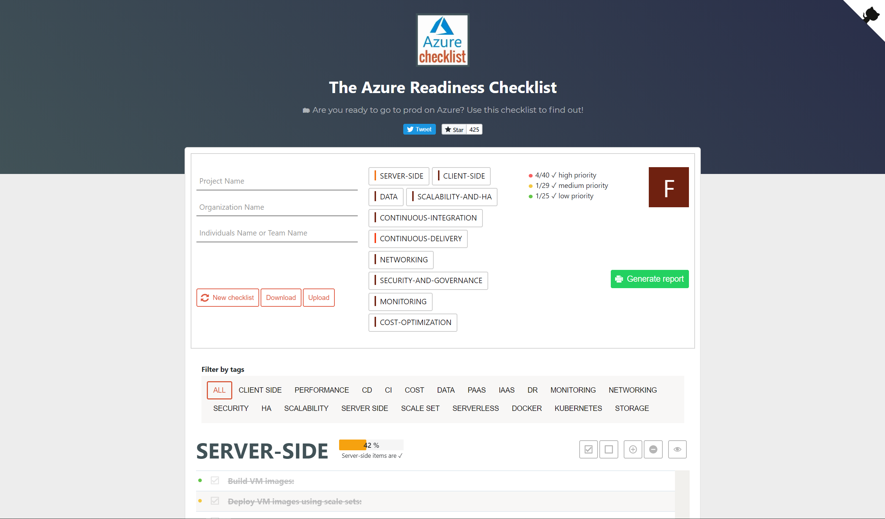
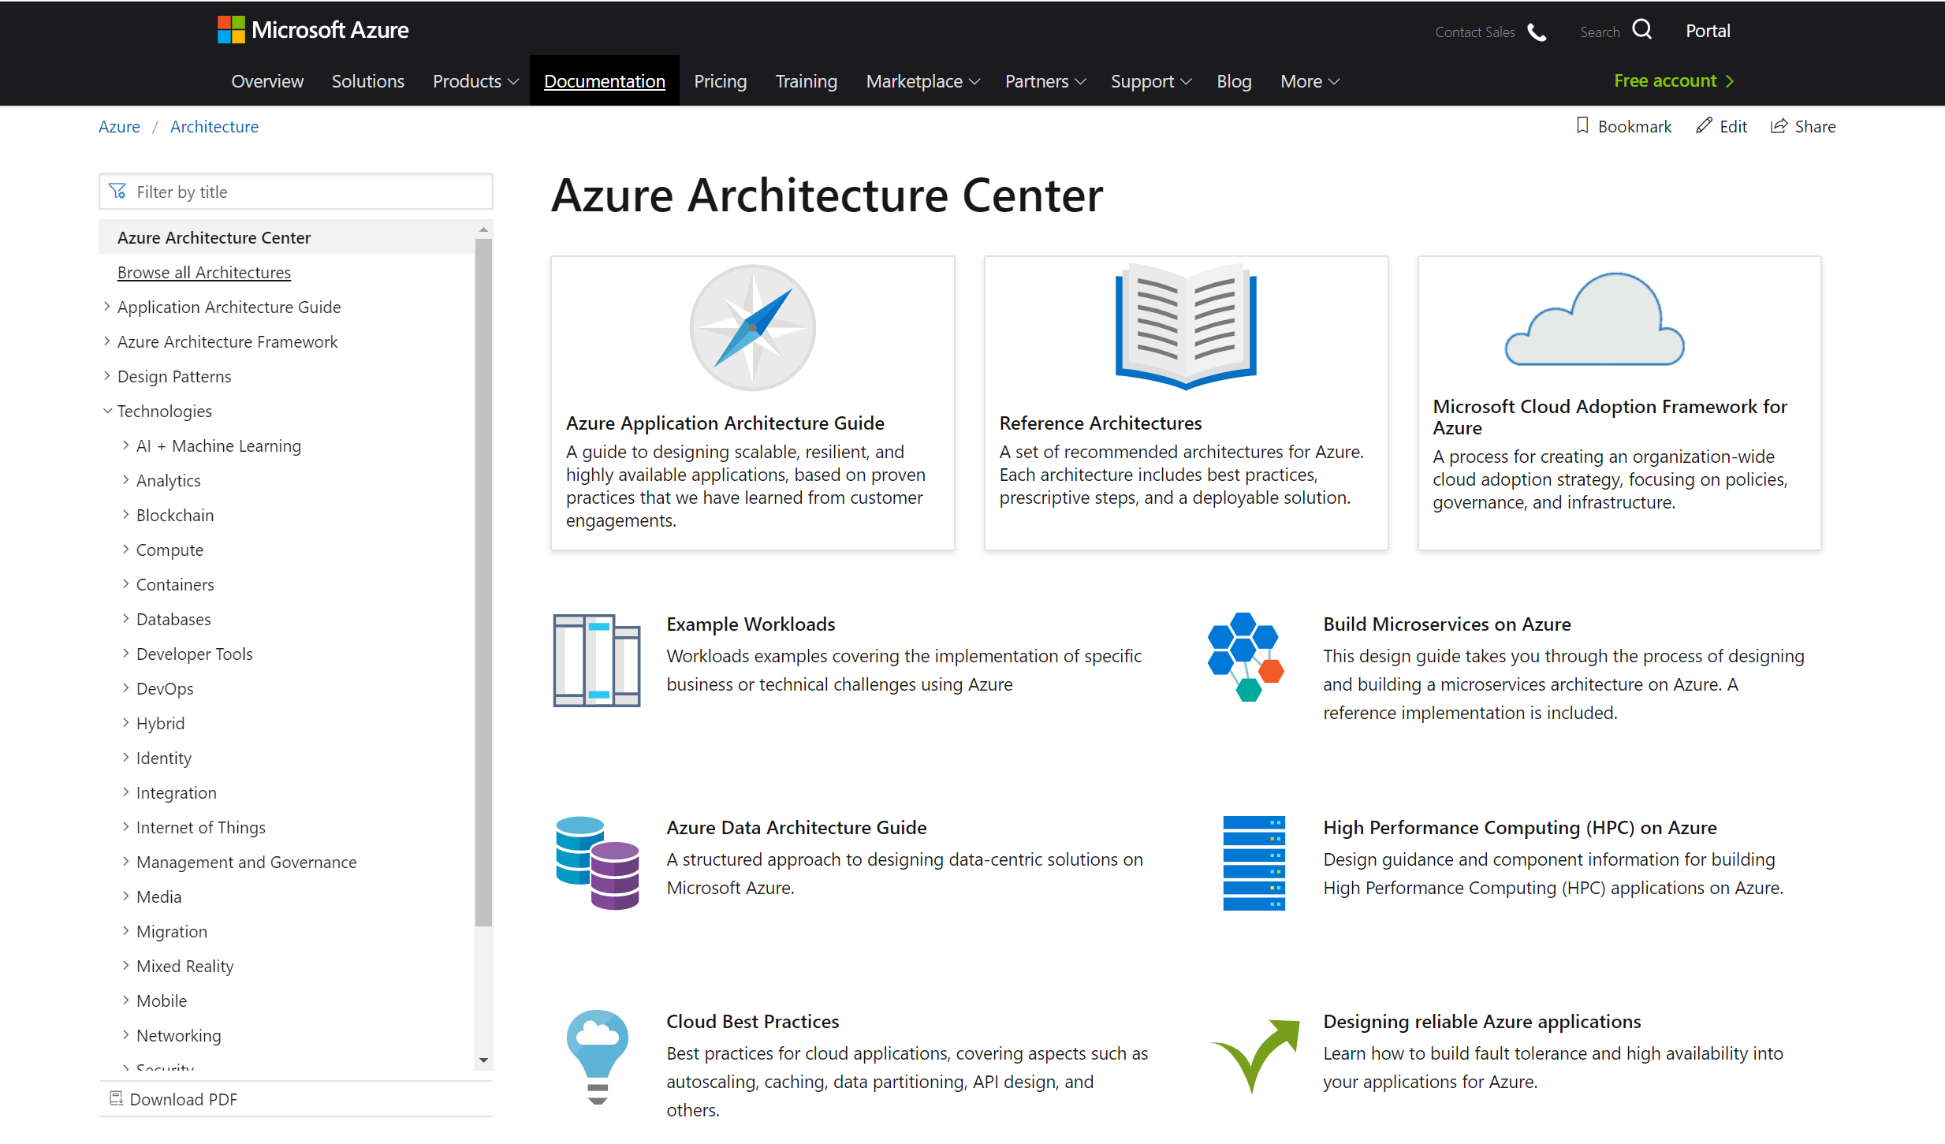
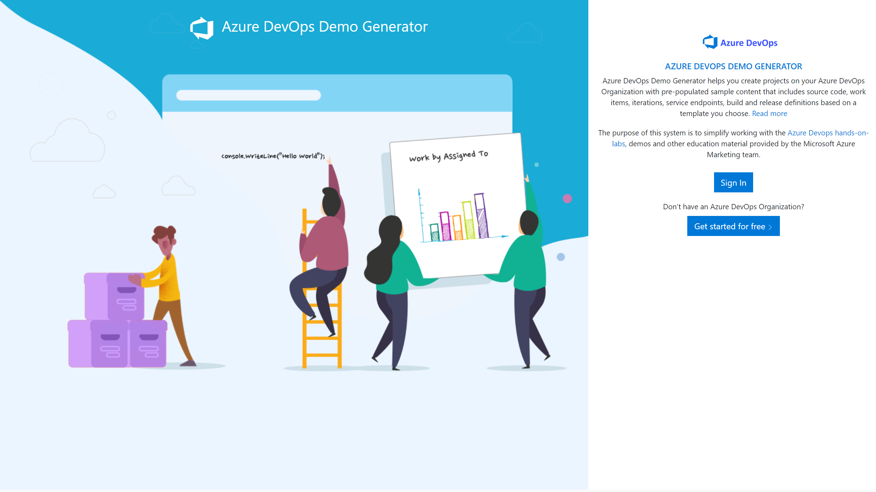
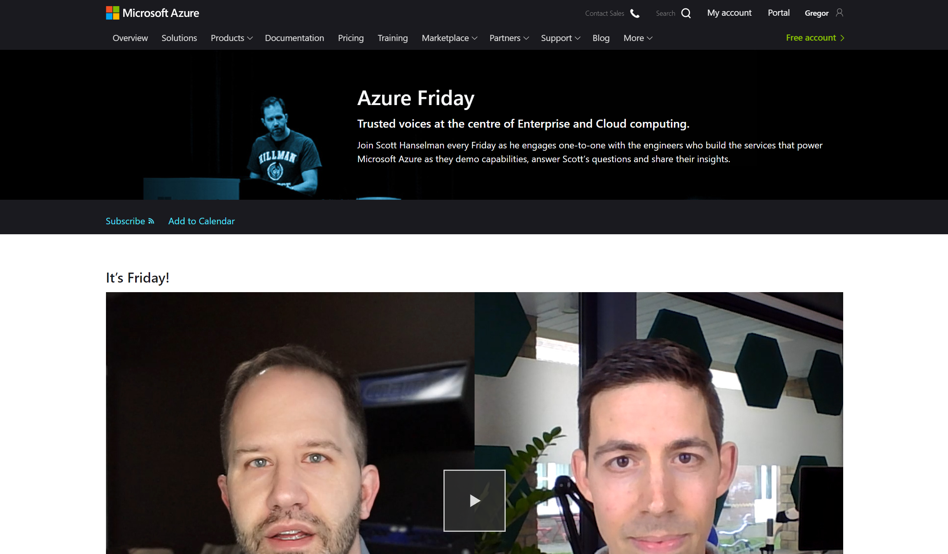
Experienced in Azure
Lot’s of great resources out there
AzureChecklist.com
Azure Architecture Centre
Azure DevOps Demo Generator
Azure Friday
Notes:
Azurechecklist.com – this is handy if your going to production and have a type of project, this is a checklist of things to check off that you have in place before going into production, things like key vault etc
Azure Architecture centre – This is where you will find reference architecture, example workloads, cloud best practices and a tonne more
Azure Devops Generator – This is a great site for learning about Azure Devops and has some cracking Azure Devops labs you can work through.

Slide 17
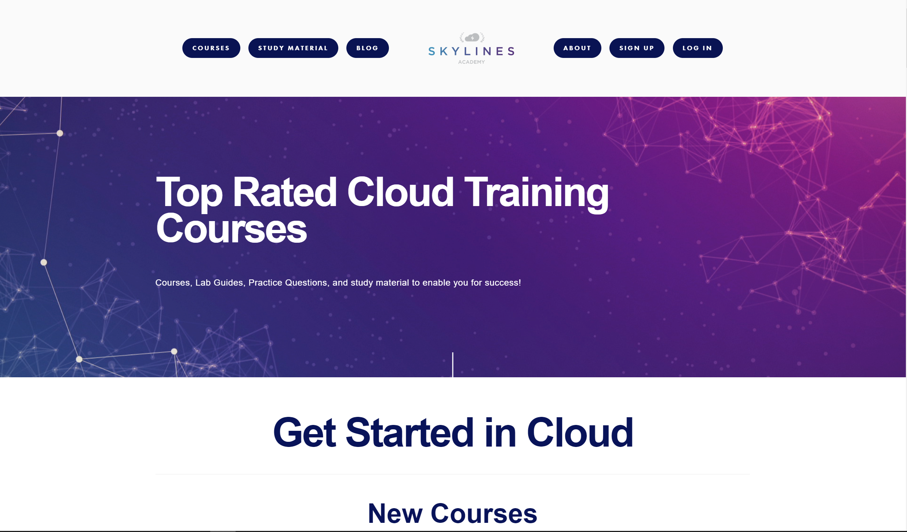
Paid Training Materials
Lot’s of great resources out there
SkylinesAcademy.com
Pluralsight.com
ACloudGuru.com
Udemy.com
WhizLabs.com
MeasureUp.com

Slide 18
Community Resources
Azure Blog’s
YouTube
User Groups & Virtual Conferences
GitHub Resources
CloudFamily.info #cloudfamily
Community #azurefamily
Notes:
https://cloudfamily.info/
https://github.com/CloudFamily/
https://github.com/gsuttie/AzureResources

Slide 19
Demo Time
Notes:
Ok I’ve talked about a number of resources, but lets take a look at some of these now
Build5nines
https://build5nines.com/certifications/
microsot learn
https://docs.microsoft.com/en-us/learn/
Microsoft Learn Certifications
https://docs.microsoft.com/en-us/learn/certifications/
Azure OverView
Azure-overview.com
Cloud Adoption Framework
https://azure.microsoft.com/en-gb/cloud-adoption-framework/
https://azure.microsoft.com/mediahandler/files/resourcefiles/cloud-adoption-framework/Cloud%20Adoption%20Framework.pdf
Azure Citadel
https://azurecitadel.com/
AzureCharts
https://azurecharts.com/
https://azurecharts.com/overview/360adv?s=32
Azure tip n tricks
https://microsoft.github.io/AzureTipsAndTricks/
Azure Devops Demo Generator
https://azuredevopsdemogenerator.azurewebsites.net/
Azure Friday
https://azure.microsoft.com/en-us/resources/videos/azure-friday/

Slide 20
Key Takeaways
Start Today
Set yourself some goals
Failures will occur
Learn new skills
New opportunities will occur
Give back to the Community

Slide 21
What Questions do you have?

Slide 22
Contact
Twitter: @gregor_suttie
LinkedIn: https://bit.ly/2xWRYCH
Blog: https://gregorsuttie.com/
CloudFamily: https://cloudfamily.info/

Slide 23

Top 5
5
Azure Learning Resources
1
2
3
4
Top 5

Slide 24
1
3
5
2
4
Azure Top 5 Learning Resources
Top 5

Slide 25
Community Content
Azure Citadel - https://azurecitadel.com/
Visual Studio Dev Essentials - https://visualstudio.microsoft.com/dev-essentials/
Build5nines - https://build5nines.com/
Feed Spot Top 50 Azure blogs - https://blog.feedspot.com/microsoft_azure_blogs/
Azure Tips and Tricks - https://microsoft.github.io/AzureTipsAndTricks/
GitHub Azure resources - https://github.com/gsuttie/AzureResources
CloudFamily - https://github.com/CloudFamily/
1
5
2
3
4
Top 5

Slide 26
Microsoft Azure Docs
1
5
2
3
https://docs.microsoft.com/en-us/azure/
4
Top 5

Slide 27


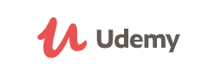
Training Companies
Skylines Academy
Educate, Enable, Empower
1
5
2
3
4
Top 5
Pluralsight
The Technology Skills Platform
Udemy

Slide 28
Microsoft Exams Training
1
2
5
3
https://docs.microsoft.com/en-us/azure/
4
Top 5

Slide 29

2
5
3
1
4
Top 5
Microsoft Learn
https://docs.microsoft.com/en-us/learn/

